Slide 1
Chapter 32 Multithreading and Parallel Programming

Slide 2
Objectives
To get an overview of multithreading (§32.2).
To develop task classes by implementing the Runnable interface (§32.3).
To create threads to run tasks using the Thread class (§32.3).
To control threads using the methods in the Thread class (§32.4).
To control animations using threads and use Platform.runLater to run the code in application thread (§32.5).
To execute tasks in a thread pool (§32.6).
To use synchronized methods or blocks to synchronize threads to avoid race conditions (§32.7).
To synchronize threads using locks (§32.8).
To facilitate thread communications using conditions on locks (§§32.9–32.10).
To use blocking queues to synchronize access to an array queue, linked queue, and priority queue (§32.11).
To restrict the number of accesses to a shared resource using semaphores (§32.12).
To use the resource-ordering technique to avoid deadlocks (§32.13).
To describe the life cycle of a thread (§32.14).
To create synchronized collections using the static methods in the Collections class (§32.15).
To develop parallel programs using the Fork/Join Framework (§32.16).

Slide 3
Processes
A process is a program that is currently running
Typically a process corresponds to a program
Each process has its own resources
  Memory (stack, heap), program counter, etc.
Each instance of a running JVM is a process

Slide 4
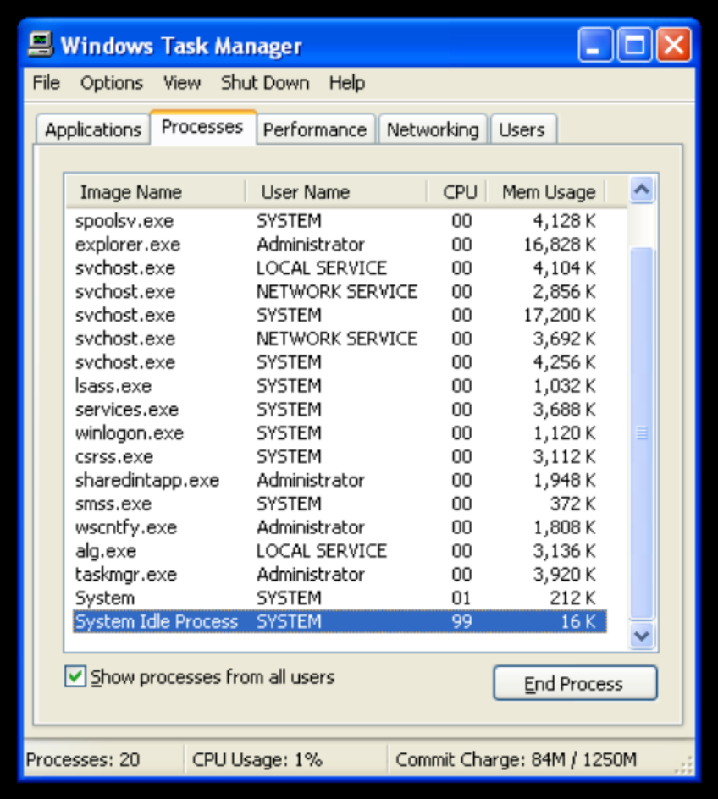
https://en.wikipedia.org/wiki/File:System_idle_process.png

Slide 5
Threads
Every process has a thread
  In Java, called the main thread
Common to have multiple threads
Threads share resources of their process
  Making threads more efficient than making processes

Slide 6
Why?
Efficiency
Single processor / core system, can have multiple programs running, but really only one executing at a time
Multiprocessor / multicore system can do things concurrently

Slide 7
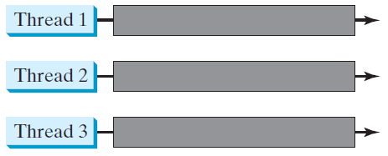
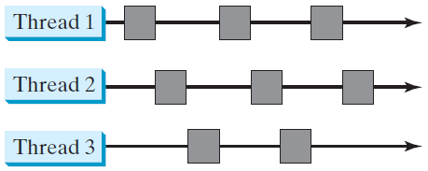
Threads Concept
Multiple threads on multiple CPUs
Multiple threads sharing a single CPU

Slide 8
Thread Concept, cont.
Figure on previous slide
Each thread can be responsible for some task or operation in the program
Allows work to be done in parallel and thus more quickly

Slide 9
Multithreading
Multithreading is using multiple threads in a single program
Some programs gain more efficiency from multithreading than others

Slide 10
A couple general scenarios for multithreading
  Large computation broken into smaller parts and done concurrently
  A program with different roles or tasks, each thread responsible for a role or task

Slide 11
Examples
Servers
  Thread for each request / client
Web Browsers
  Thread for each tab or for handling different parts of a page
GUI
  Thread for responsiveness

Slide 12
Examples
Image Processing
  Split image up, each thread work on a part of the image
Animation Rendering
  Threads for different parts or frames of the animation
I/O
  Thread to handle long I/O task, other thread to handle other role

Slide 13
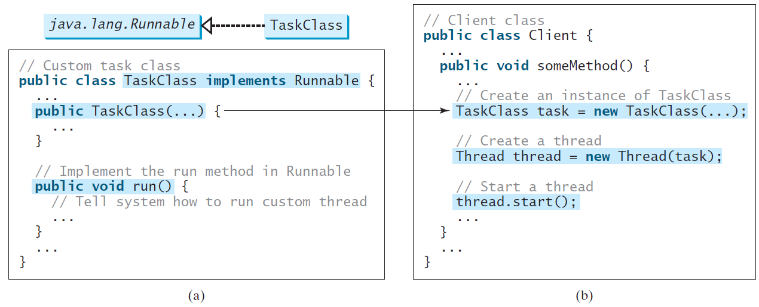
Creating Tasks and Threads

Slide 14
Tasks
If we think of threads as workers, tasks are the work we assign to them
In Java, these tasks are objects
Tasks need to be created from a class that implements the Runnable interface

Slide 15
Runnable Interface
Runnable interface requires that a run() method be implemented
run() is where the actual work to be done is specified
  run() should, generally, not be directly called

Slide 16
public class TaskClass implements Runnable
{
  TaskClass(){
    // Constructor
  }
  public void run(){
    // What thread does
  }
}

Slide 17
public class MyProgram
{
  public static void main(String[] args)
  {
    TaskClass task = new TaskClass();
    Thread thread = new Thread(task);
    thread.start();
  }
}

Slide 18
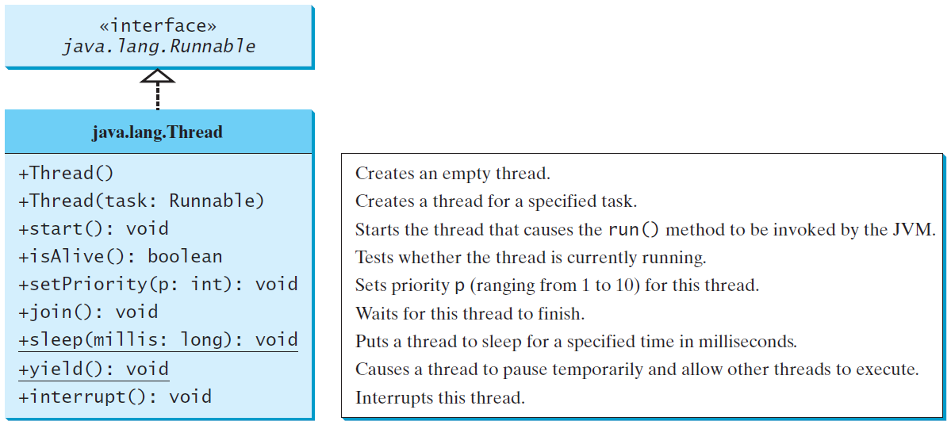
The Thread Class

Slide 19
Example:
Using the Runnable Interface to Create and Launch Threads
Objective: Create and run three threads:
  The first thread prints the letter a 100 times.
  The second thread prints the letter b 100 times.
  The third thread prints the integers 1 through 100.
TaskThreadDemo
Run

Slide 20
Thread Class
Thread objects represent threads
Thread class itself actually implements Runnable
  So one could subclass Thread and implement run(), combining roles of a task and a thread

Slide 21
public class CustomThread extends Thread
{
  CustomThread(){
    // Constructor
  }
  public void run(){
    // What thread does
  }
}

Slide 22
public class Program
{
  public static void main(String[] args)
  {
    CustomThread thread = new CustomThread();
    thread.start();
  }
}

Slide 23
Several operations can be performed on a thread
start() is what actually kicks off the thread and makes it start doing it’s work / task

Slide 24
yield() tells the thread to temporarily release its time using the CPU
  Allows other threads to have a turn

Slide 25
The Static yield() Method
You can use the yield() method to temporarily release time for other threads. For example, suppose you modify the code in Lines 53-57 in TaskThreadDemo.java as follows:
  public void run() {
  for (int i = 1; i <= lastNum; i++) {
  System.out.print(" " + i);
  Thread.yield();
  }
  }
Every time a number is printed, the print100 thread is yielded. So, the numbers are printed after the characters.

Slide 26
sleep() puts a thread to sleep (pauses) for a specified amount of time
  Input in milliseconds
  Other threads can run while the thread is sleeping
  Calls to sleep() need to be put in a try block

Slide 27
The Static sleep(milliseconds) Method
The sleep(long mills) method puts the thread to sleep for the specified time in milliseconds. For example, suppose you modify the code in Lines 53-57 in TaskThreadDemo.java as follows:
  public void run() {
  for (int i = 1; i <= lastNum; i++) {
  System.out.print(" " + i);
  try {
  if (i >= 50) Thread.sleep(1);
  }
  catch (InterruptedException ex) {
  }
  }
  }
Every time a number (>= 50) is printed, the print100 thread is put to sleep for 1 millisecond.

Slide 28
join() is a way to wait for another thread to finish running
  join() is called on the thread you want to wait for (or join up with)
    To wait until thread4 had finished running its run() method, we would write:
      thread4.join();

Slide 29
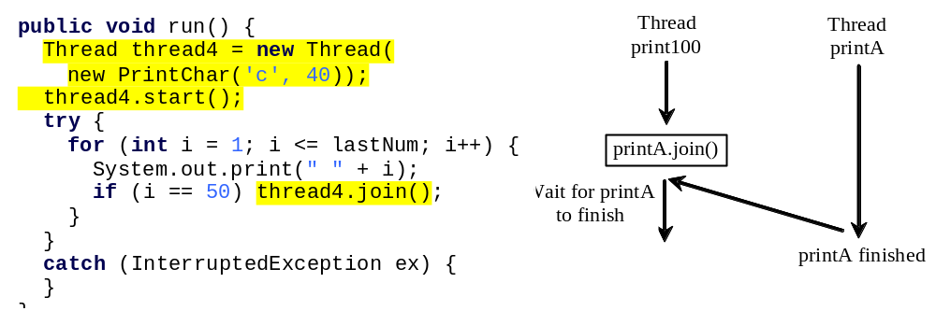
The join() Method
You can use the join() method to force one thread to wait for another thread to finish. For example, suppose you modify the code in Lines 53-57 in TaskThreadDemo.java as follows:
The numbers after 50 are printed after thread printA is finished.

Slide 30
isAlive(), interrupt(), and isInterrupted()
The isAlive() method is used to find out the state of a thread. It returns true if a thread is in the Ready, Blocked, or Running state; it returns false if a thread is new and has not started or if it is finished.
The interrupt() method interrupts a thread in the following way: If a thread is currently in the Ready or Running state, its interrupted flag is set; if a thread is currently blocked, it is awakened and enters the Ready state, and an java.io.InterruptedException is thrown.
The isInterrupt() method tests whether the thread is interrupted.

Slide 31
The deprecated stop(), suspend(), and resume() Methods
NOTE: The Thread class also contains the stop(), suspend(), and resume() methods. As of Java 2, these methods are deprecated (or outdated) because they are known to be inherently unsafe. You should assign null to a Thread variable to indicate that it is stopped rather than use the stop() method.

Slide 32
Priorities
Threads have priorities
In Java, priorities range from (lowest) 1 to 10 (highest)
  MIN_PRIORITY = 1, NORM_PRIORITY = 5, MAX_PRIORITY = 10
  main thread has NORM_PRIORITY
getPriority() and setPriority()

Slide 33
Thread Priority
Each thread is assigned a default priority of Thread.NORM_PRIORITY. You can reset the priority using setPriority(int priority).
Some constants for priorities include Thread.MIN_PRIORITY Thread.MAX_PRIORITY Thread.NORM_PRIORITY

Slide 34
Schemes of determining which threads run are called scheduling
JVM runs the thread with the highest priority
If several threads with equal priority, they take turns (round-robin scheduling)
  Example: 8 high priority threads, only 4 cores.. threads have to take turns

Slide 35
Lower priority threads can only run when none of higher priority are running
Lower priority threads might not get a chance to run (starvation)
  Example: 4 high priority threads running, only 4 cores, and 1 low priority thread.. low priority will get starved
Starvation can be avoided by yield() and sleep() calls in high priority threads

Slide 36


Example: Flashing Text
FlashText
Run

Slide 37
Thread Pools
So far, learned how to make a task and a thread to perform that task
Convenient for a single task, not efficient for a large number of tasks
  Creating a thread for each task
  Some overhead to create and destroy a thread
  Better to make a few threads and reuse them

Slide 38
Thread Pools
For a large quantity of tasks, better to use a thread pool
  Imagine a crew of five workers and hundreds of tasks
  Gradually feed tasks to workers to finish
  When a worker finishes, it gets another task
Thread pools are sometimes called worker crew model

Slide 39
Thread Pools
Several pieces used with thread pools
  Executor interface
  ExecutorService interface
  Executors class
Need to add an import statement for these
  import java.util.concurrent.*;

Slide 40
Executor Interface
An object that implements the Executor interface can run a task (an object that implements Runnable)
  Specifically, Executor has an execute() method for running a task
    executor.execute(task);

Slide 41
ExecutorService Interface
ExecutorService is a subinterface of Executor
Provides methods for managing a thread pool
  shutdown() – stops thread pool, finishes submitted tasks
  shutdownNow() – stops thread pool, does not finish tasks
  isShutdown() – tells whether thread pool is shut down

Slide 42
Executors Class
Used to actually create a thread pool
Two static methods for creating thread pools
  newFixedThreadPool() – creates a thread pool with the specified number of threads
  newCachedThreadPool() – creates a thread pool, but dynamically manages the number of threads

Slide 43
public static void main(String[] args)
{
  ExecutorService threadPool = Executors.newFixedThreadPool(5);
  ...
  threadPool.execute(task1);
  threadPool.execute(task2);
  threadPool.execute(task3);
  ...
  threadPool.execute(taskN);
  threadPool.shutdown();
}

Slide 44
Example
ExecutorDemo.java
  Try adding more tasks
  Try changing number of threads
  Try using newCachedThreadPool()

Slide 45
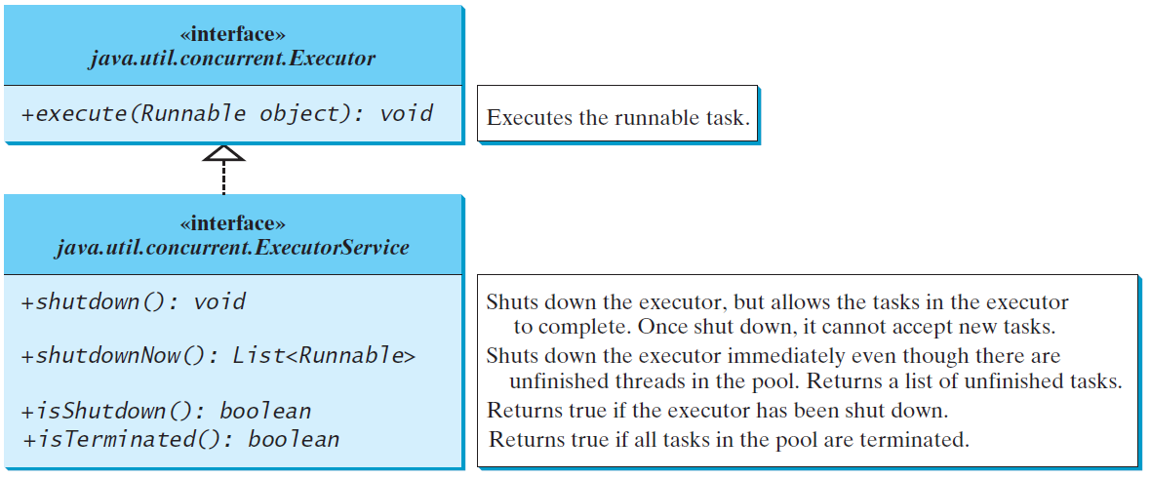
Thread Pools
Starting a new thread for each task could limit throughput and cause poor performance. A thread pool is ideal to manage the number of tasks executing concurrently. JDK 1.5 uses the Executor interface for executing tasks in a thread pool and the ExecutorService interface for managing and controlling tasks. ExecutorService is a subinterface of Executor.

Slide 46
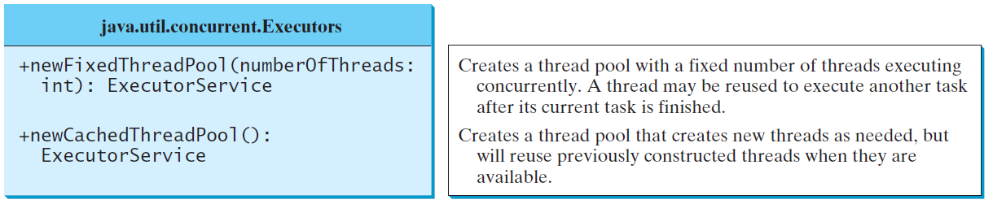
Creating Executors
To create an Executor object, use the static methods in the Executors class.
ExecutorDemo
Run

Slide 47
Thread Synchronization
Multithreading can increase efficiency
However, threads aren't necessarily team players
Threads can trample over and mess up each others work
  Can happen when multiple threads are trying to access a shared resource (e.g., a variable)

Slide 48
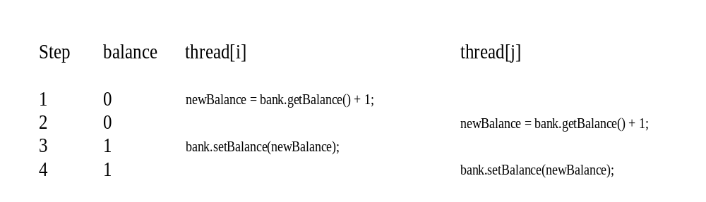
Thread Synchronization
A shared resource may be corrupted if it is accessed simultaneously by multiple threads. For example, two unsynchronized threads accessing the same bank account may cause conflict.

Slide 49
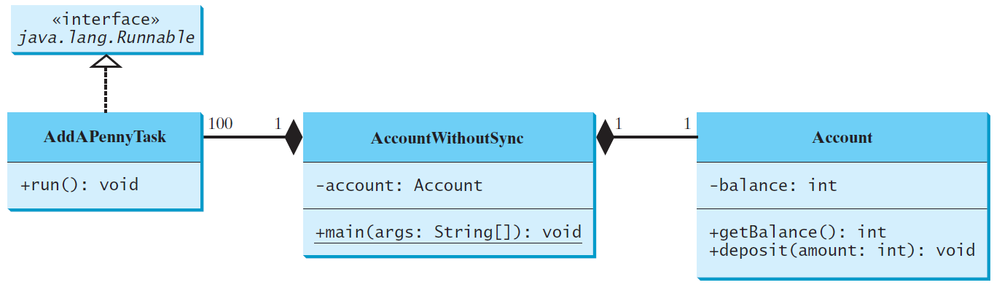
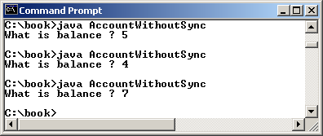
Example: Showing Resource Conflict
Objective: Write a program that demonstrates the problem of resource conflict. Suppose that you create and launch one hundred threads, each of which adds a penny to an account. Assume that the account is initially empty.
AccountWithoutSync
Run

Slide 50
AccountWithoutSync.java
  Several threads are created and each tasked with adding a penny to the same account
  Account should have a hundred pennies when done
What happened?

Slide 51
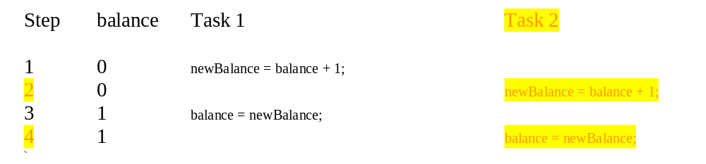
Race Condition
What, then, caused the error in the example? Here is a possible scenario:
The effect of this scenario is that Task 1 did nothing, because in Step 4 Task 2 overrides Task 1's result. Obviously, the problem is that Task 1 and Task 2 are accessing a common resource in a way that causes conflict. This is a common problem known as a race condition in multithreaded programs. A class is said to be thread-safe if an object of the class does not cause a race condition in the presence of multiple threads. As demonstrated in the preceding example, the Account class is not thread-safe.

Slide 52
Race Conditions
One type of bug that can happen in multithreaded programs is called a race condition
A race condition is when events are happening in an unintended or conflicting order
If something is thread safe, it means race conditions are not a problem for it and thus it's safe for use with multiple threads

Slide 53
A couple common scenarios for race conditions
  When threads are using a shared resource, but aren't being properly synchronized
  When threads are dependent on each other, but not being properly synchronized
Solution:
To prevent race conditions like in the example, we need to prevent multiple threads from trying to use the shared resource at the same time
Places in the program where it's dangerous for multiple threads to use at the same time are called critical regions

Slide 54
The synchronized keyword
To avoid race conditions, more than one thread must be prevented from simultaneously entering certain part of the program, known as critical region.
The critical region in the Listing 32.5 is the entire deposit method.
You can use the synchronized keyword to synchronize the method so that only one thread can access the method at a time.
There are several ways to correct the problem in Listing 32.5, one approach is to make Account thread-safe by adding the synchronized keyword in the deposit method in Line 45 as follows:
  public synchronized void deposit(double amount)

Slide 55
Synchronized, cont.
synchronized keyword is a way to prevent multiple threads from doing a certain piece of code at the same time
Code that is synchronized can only have one thread doing that piece of code at a time
Other threads that try to will have to wait until the other thread finishes
Keyword can be applied to an entire method or to a block of code

Slide 56
Synchronization, cont.
For a method…
  public synchronized void deposit(double amount)
  {
    // Critical region
  }
And, for a block…
  synchronized (expression)
  {
  // Critical region
  }

Slide 57
Synchronization, cont.
For the block of code version, expression must come out to be a reference to some object
  So it could be an object itself or a method call that returns an object, etc.

Slide 58
Synchronizing Instance Methods and Static Methods
A synchronized method acquires a lock before it executes. In the case of an instance method, the lock is on the object for which the method was invoked.
In the case of a static method, the lock is on the class.
If one thread invokes a synchronized instance method (respectively, static method) on an object, the lock of that object (respectively, class) is acquired first, then the method is executed, and finally the lock is released.
Another thread invoking the same method of that object (respectively, class) is blocked until the lock is released.

Slide 59
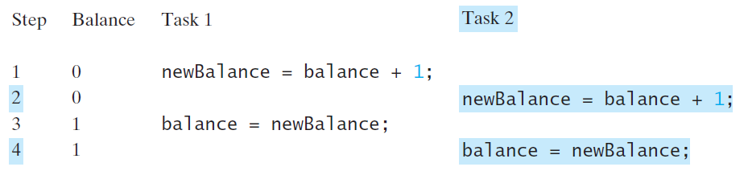
Synchronizing Instance Methods and Static Methods
With the deposit method synchronized, the preceding scenario cannot happen. If Task 2 starts to enter the method, and Task 1 is already in the method, Task 2 is blocked until Task 1 finishes the method.

Slide 60
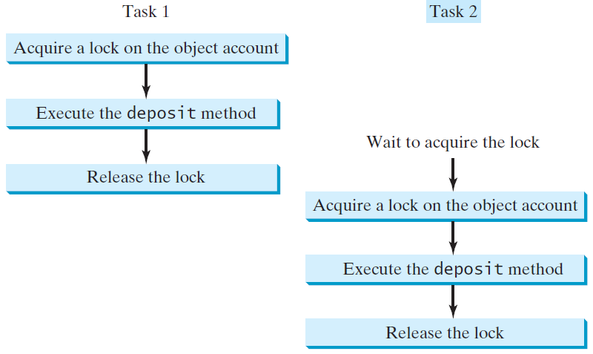
Synchronizing Tasks

Slide 61
Synchronizing Statements
Invoking a synchronized instance method of an object acquires a lock on the object, and invoking a synchronized static method of a class acquires a lock on the class.
A synchronized statement can be used to acquire a lock on any object, not just this object, when executing a block of the code in a method. This block is referred to as a synchronized block. The general form of a synchronized statement is as follows:
  synchronized (expr) {
  statements;
  }
The expression expr must evaluate to an object reference. If the object is already locked by another thread, the thread is blocked until the lock is released. When a lock is obtained on the object, the statements in the synchronized block are executed, and then the lock is released.

Slide 62
Synchronizing Statements vs. Methods
Any synchronized instance method can be converted into a synchronized statement. Suppose that the following is a synchronized instance method:
  public synchronized void xMethod() {
  // method body
  }
This method is equivalent to
  public void xMethod() {
  synchronized (this) {
  // method body
  }
  }

Slide 63
Locks, Semaphores, and Signals
Java has a synchronized keyword for synchronization
Traditionally, several other approaches
  Locks
  Semaphores
  Signals

Slide 64
Locks
synchronized keyword actually using an implicit lock
Can also explicitly make and use locks
  Greater flexibility and control
  Can also have conditions to facilitate thread communication
Need to import java.util.concurrent.locks.*;

Slide 65
Lock Interface
Lock is an interface
Classes that implement Lock interface must implement
  lock() – lock the lock
  unlock() – unlock the lock
  newCondition() – used with signals (more later..)

Slide 66
ReentrantLock Class
ReentrantLock is a concrete class that implements the Lock interface
Allows for the creation of a mutually exclusive lock
  Only one thread can have the lock at a time

Slide 67
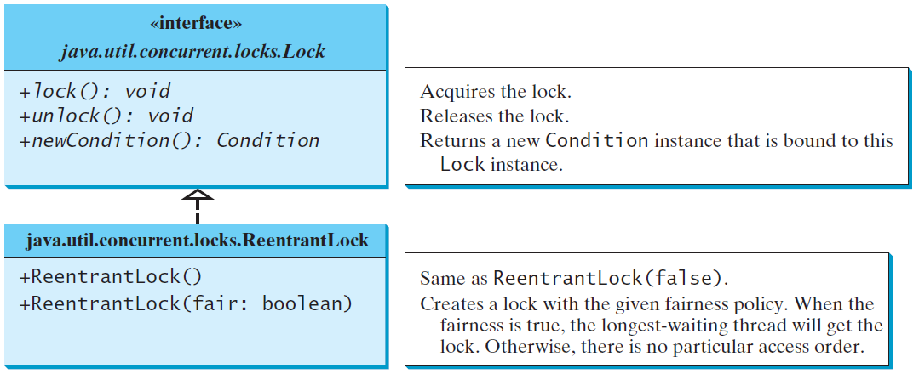
Synchronization Using Locks
A synchronized instance method implicitly acquires a lock on the instance before it executes the method.
JDK 1.5 enables you to use locks explicitly. The new locking features are flexible and give you more control for coordinating threads. A lock is an instance of the Lock interface, which declares the methods for acquiring and releasing locks. A lock may also use the newCondition() method to create any number of Condition objects, which can be used for thread communications.

Slide 68
ReentrantLocks and Fairness
ReentrantLocks have a fairness policy
  True fairness is the longest waiting thread gets the lock
  False fairness is arbitrary
isFair() – returns true if true fairness enabled, false if not
True fairness can be enabled with ReentrantLock() constructor

Slide 69
Fairness Policy
ReentrantLock is a concrete implementation of Lock for creating mutual exclusive locks.
You can create a lock with the specified fairness policy.
True fairness policies guarantee the longest-wait thread to obtain the lock first. False fairness policies grant a lock to a waiting thread without any access order.
Programs using fair locks accessed by many threads may have poor overall performance than those using the default setting, but have smaller variances in times to obtain locks and guarantee lack of starvation.

Slide 70
Example: Using Locks
This example revises AccountWithoutSync.java to synchronize the account modification using explicit locks.
Account class has a static lock
  Shared between objects
Locks at the beginning of critical section
Unlocks at the end of the critical section
AccountWithSyncUsingLock
Run

Slide 71
Conditions
Synchronization using synchronized keywords or locks suffices to avoid race conditions
Sometimes need threads to do more than simply not interfere with each other
Want threads to actually cooperate or communicate
Can use conditions to do so

Slide 72
Conditions, cont.
A condition is an object associated with a lock
Created via the lock's newCondition() method
Lock must be owned to call operations on its conditions
  i.e., operation calls must be after lock() call

Slide 73
Conditions, cont.
Common operations are:
  await() – causes thread to wait for the condition
  signal() – tells a thread the condition has happened
  signalAll() – tells all threads the condition has happened

Slide 74
Two guys
  One guy at bank continuously trying to make withdraws
    If account has amount, makes withdraw
    If doesn't, waits until told deposit was made
Other guy at home, continuously making deposits
  Tells guy at bank when a deposit has been made
Two guys are threads
A deposit being made is the condition

Slide 75
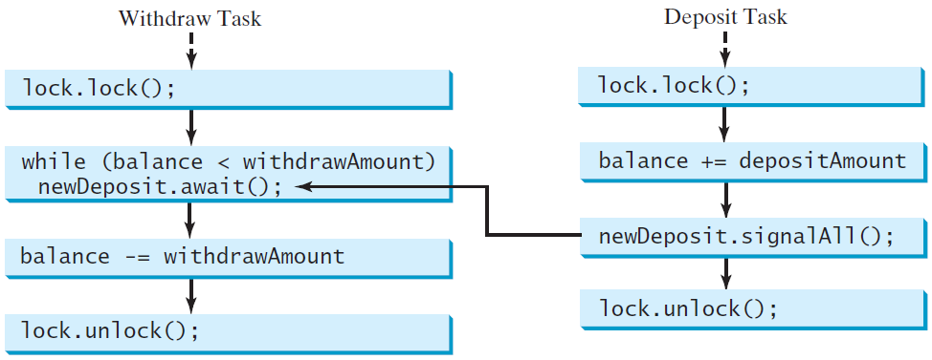
Cooperation Among Threads
To synchronize the operations, use a lock with a condition: newDeposit (i.e., new deposit added to the account). If the balance is less than the amount to be withdrawn, the withdraw task will wait for the newDeposit condition. When the deposit task adds money to the account, the task signals the waiting withdraw task to try again.

Slide 76
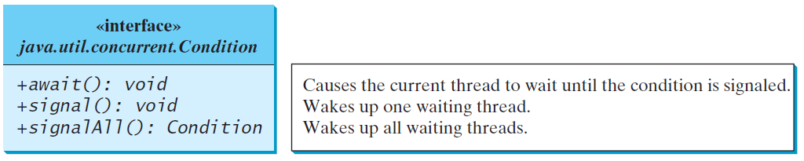
Cooperation Among Threads
The conditions can be used to facilitate communications among threads. A thread can specify what to do under a certain condition. Conditions are objects created by invoking the newCondition() method on a Lock object. Once a condition is created, you can use its await(), signal(), and signalAll() methods for thread communications. The await() method causes the current thread to wait until the condition is signaled. The signal() method wakes up one waiting thread, and the signalAll() method wakes all waiting threads.

Slide 77
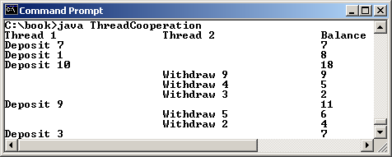
Example: Thread Cooperation
Write a program that demonstrates thread cooperation. Suppose that you create and launch two threads, one deposits to an account, and the other withdraws from the same account. The second thread has to wait if the amount to be withdrawn is more than the current balance in the account. Whenever new fund is deposited to the account, the first thread notifies the second thread to resume. If the amount is still not enough for a withdrawal, the second thread has to continue to wait for more fund in the account. Assume the initial balance is 0 and the amount to deposit and to withdraw is randomly generated.
DepositTask and WithdrawTask
Depositor uses signalAll()
Withdrawer uses await()
ThreadCooperation
Run

Slide 78
Java’s Built-in Monitors (Optional)
Locks and conditions are new in Java 5. Prior to Java 5, thread communications are programmed using object’s built-in monitors. Locks and conditions are more powerful and flexible than the built-in monitor. For this reason, this section can be completely ignored. However, if you work with legacy Java code, you may encounter the Java’s built-in monitor. A monitor is an object with mutual exclusion and synchronization capabilities. Only one thread can execute a method at a time in the monitor. A thread enters the monitor by acquiring a lock on the monitor and exits by releasing the lock. Any object can be a monitor. An object becomes a monitor once a thread locks it. Locking is implemented using the synchronized keyword on a method or a block. A thread must acquire a lock before executing a synchronized method or block. A thread can wait in a monitor if the condition is not right for it to continue executing in the monitor.

Slide 79
wait(), notify(), and notifyAll()
Use the wait(), notify(), and notifyAll() methods to facilitate communication among threads.
The wait(), notify(), and notifyAll() methods must be called in a synchronized method or a synchronized block on the calling object of these methods. Otherwise, an IllegalMonitorStateException would occur.
The wait() method lets the thread wait until some condition occurs. When it occurs, you can use the notify() or notifyAll() methods to notify the waiting threads to resume normal execution. The notifyAll() method wakes up all waiting threads, while notify() picks up only one thread from a waiting queue.

Slide 80
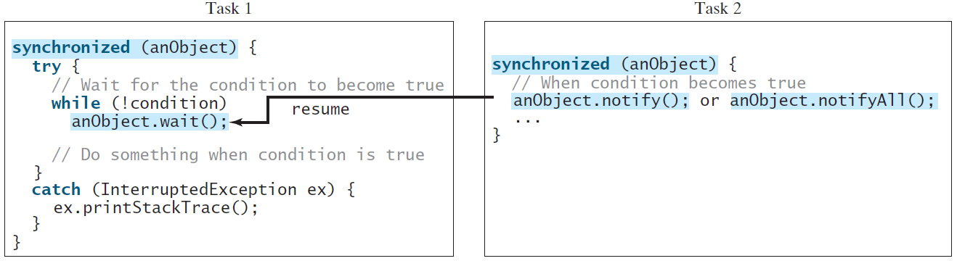
Example: Using Monitor
The wait(), notify(), and notifyAll() methods must be called in a synchronized method or a synchronized block on the receiving object of these methods. Otherwise, an IllegalMonitorStateException will occur.
When wait() is invoked, it pauses the thread and simultaneously releases the lock on the object. When the thread is restarted after being notified, the lock is automatically reacquired.
The wait(), notify(), and notifyAll() methods on an object are analogous to the await(), signal(), and signalAll() methods on a condition.

Slide 81
Producer Consumer Problem
Classic synchronization problem
Involves two threads:
  Producer wants to continuously write to a buffer
    Buffer basically a queue in this case
  Consumer wants to continuously read from the buffer

Slide 82
Producer Consumer, cont.
Suppose buffer only has 1 slot
Producer cannot write to buffer if it is full
  So it must wait until the buffer is empty
Consumer cannot read from buffer if it is empty
  So it must wait until the buffer is full
After producer writes, signals that buffer not empty
After consumer reads, signals that buffer is not full

Slide 83
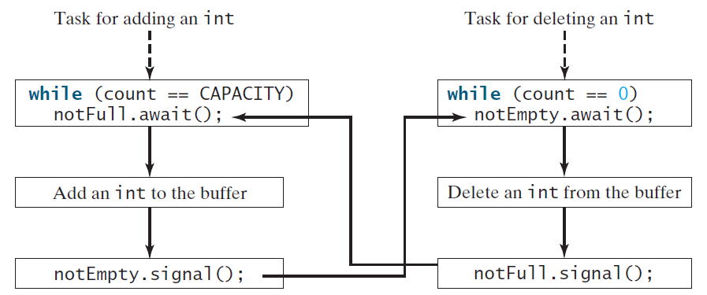
Case Study: Producer/Consumer (Optional)
Consider the classic Consumer/Producer example. Suppose you use a buffer to store integers. The buffer size is limited. The buffer provides the method write(int) to add an int value to the buffer and the method read() to read and delete an int value from the buffer. To synchronize the operations, use a lock with two conditions: notEmpty (i.e., buffer is not empty) and notFull (i.e., buffer is not full). When a task adds an int to the buffer, if the buffer is full, the task will wait for the notFull condition. When a task deletes an int from the buffer, if the buffer is empty, the task will wait for the notEmpty condition.

Slide 84
Case Study: Producer/Consumer (Optional)
Listing 32.8 presents the complete program. The program contains the Buffer class (lines 43-89) and two tasks for repeatedly producing and consuming numbers to and from the buffer (lines 15-41). The write(int) method (line 58) adds an integer to the buffer. The read() method (line 75) deletes and returns an integer from the buffer.
For simplicity, the buffer is implemented using a linked list (lines 48-49). Two conditions notEmpty and notFull on the lock are created in lines 55-56. The conditions are bound to a lock. A lock must be acquired before a condition can be applied. If you use the wait() and notify() methods to rewrite this example, you have to designate two objects as monitors.
Uses two conditions
ConsumerProducer
Run

Slide 85
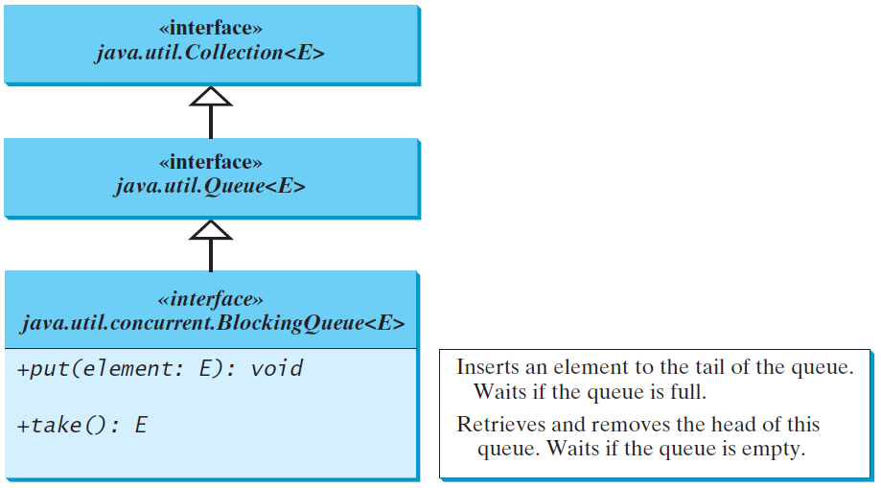
Blocking Queues (Optional)
§22.8 introduced queues and priority queues. A blocking queue causes a thread to block when you try to add an element to a full queue or to remove an element from an empty queue.

Slide 86
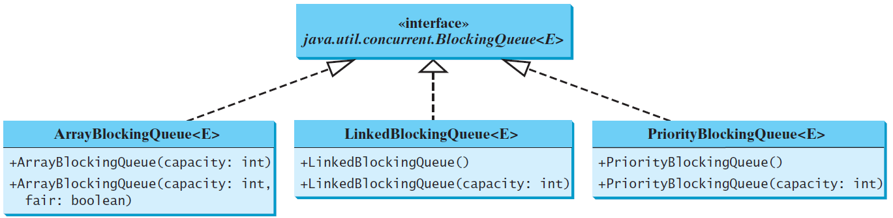
Concrete Blocking Queues
Three concrete blocking queues ArrayBlockingQueue, LinkedBlockingQueue, and PriorityBlockingQueue are supported in JDK 1.5. All are in the java.util.concurrent package. ArrayBlockingQueue implements a blocking queue using an array. You have to specify a capacity or an optional fairness to construct an ArrayBlockingQueue. LinkedBlockingQueue implements a blocking queue using a linked list. You may create an unbounded or bounded LinkedBlockingQueue. PriorityBlockingQueue is a priority queue. You may create an unbounded or bounded priority queue.

Slide 87
Producer/Consumer Using Blocking Queues
The program gives an example of using an ArrayBlockingQueue for the Consumer/Producer problem.
ConsumerProducerUsingBlockingQueue
Run

Slide 88
Semaphores
Semaphores are basically a locks
Locks are mutually exclusive
  Only one thread can have at a time
Semaphores can allow a restricted number of threads to have simultaneous access
  Each thread must have a permit

Slide 89
Semaphores
When a semaphore is created, it's number of permits is specified in the constructor
Two common operations:
  acquire() – acquires a permit (kinda like lock())
  release() – releases a permit (kinda like unlock())
A semaphore with a single permit could be used like a lock
Refer to listing 32.9, implements Account class with a semaphore.

Slide 90
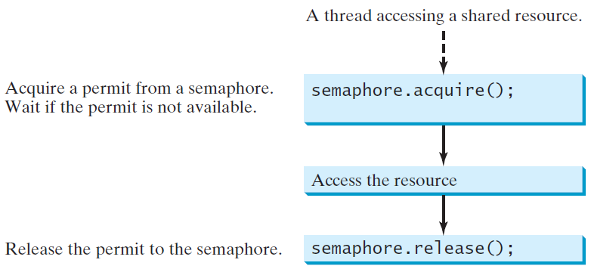
Semaphores (Optional)
Semaphores can be used to restrict the number of threads that access a shared resource. Before accessing the resource, a thread must acquire a permit from the semaphore. After finishing with the resource, the thread must return the permit back to the semaphore.

Slide 91
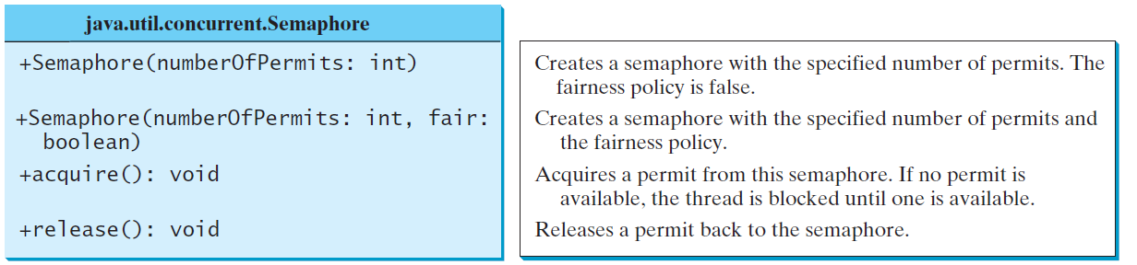
Creating Semaphores
To create a semaphore, you have to specify the number of permits with an optional fairness policy. A task acquires a permit by invoking the semaphore’s acquire() method and releases the permit by invoking the semaphore’s release() method. Once a permit is acquired, the total number of available permits in a semaphore is reduced by 1. Once a permit is released, the total number of available permits in a semaphore is increased by 1.

Slide 92
Deadlocks
Another type of bug that can happen in multithreading is deadlocks
A deadlock happens when there are multiple threads and multiple locks
  thread1 has locked lock1 and is waiting to lock lock2, thread2 has locked lock2 and is waiting to lock lock1

Slide 93
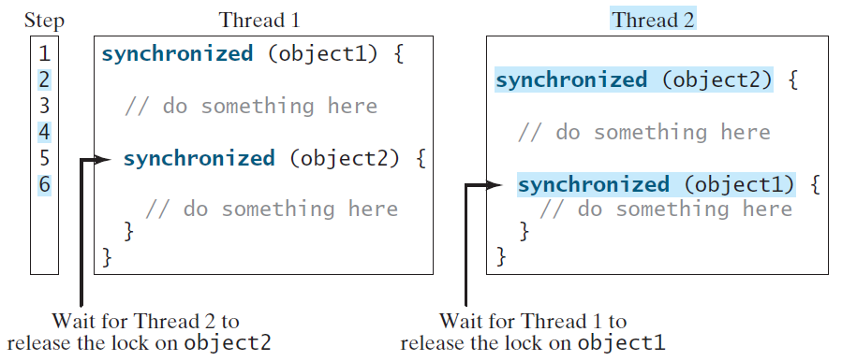
Deadlock
Sometimes two or more threads need to acquire the locks on several shared objects. This could cause deadlock, in which each thread has the lock on one of the objects and is waiting for the lock on the other object. Consider the scenario with two threads and two objects. Thread 1 acquired a lock on object1 and Thread 2 acquired a lock on object2. Now Thread 1 is waiting for the lock on object2 and Thread 2 for the lock on object1. The two threads wait for each other to release the in order to get the lock, and neither can continue to run.

Slide 94
Preventing Deadlock
Deadlock can be easily avoided by using a simple technique known as resource ordering.
With this technique, you assign an order on all the objects whose locks must be acquired and ensure that each thread acquires the locks in that order.
For the example, suppose the objects are ordered as object1 and object2. Using the resource ordering technique, Thread 2 must acquire a lock on object1 first, then on object2. Once Thread 1 acquired a lock on object1, Thread 2 has to wait for a lock on object1. So Thread 1 will be able to acquire a lock on object2 and no deadlock would occur.

Slide 95
Five thread states:
Five thread states:
  New – Thread object created
  Ready – initiated by called start(), ready to be run by the CPU
  Running – actually running on the CPU, run() method running
  Blocked – basically paused or waiting
  Finished – completed run() method

Slide 96
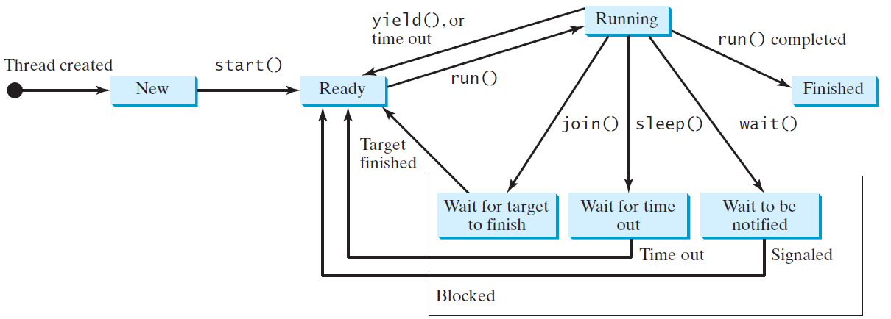
Thread States
A thread can be in one of five states:
  New, Ready, Running, Blocked, or Finished.
Operations often change a threads state

Slide 97
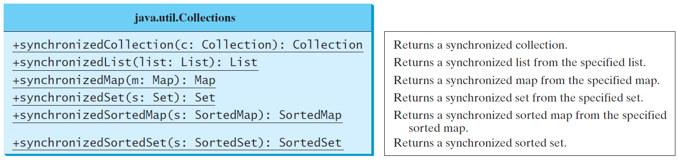
Synchronized Collections
The classes in the Java Collections Framework are not thread-safe, i.e., the contents may be corrupted if they are accessed and updated concurrently by multiple threads. You can protect the data in a collection by locking the collection or using synchronized collections.
The Collections class provides six static methods for wrapping a collection into a synchronized version. The collections created using these methods are called synchronization wrappers.

Slide 98
Multithreading -> Parallel Programming
One application of multithreading is to break a large problem into parts and do the parts in parallel
Newer trend in software development
Utilizes multiple cores / processors for efficiency

Slide 99
Multithreading -> Parallel Programming
Software does not automatically use multiple cores
Must be designed to use them
Parallel programming is writing software to use multiple cores

Slide 100
Fork/Join
Could be done with individual threads
Java 7 introduced Fork / Join Framework
Makes parallel programming more convenient, especially divide and conquer algorithms
Break problem into non-overlapping subproblems

Slide 101
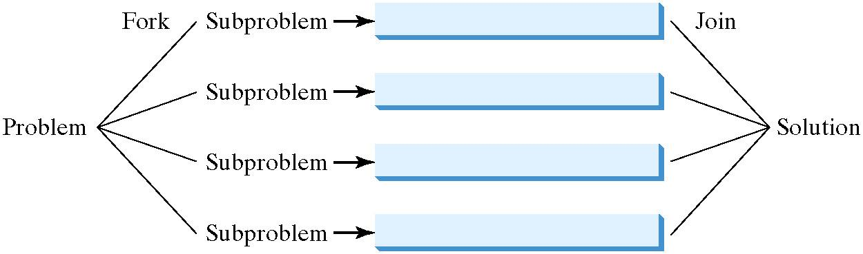
The Fork/Join Framework
The Fork/Join Framework is used for parallel programming in Java.
In JDK 7’s Fork/Join Framework, a fork can be viewed as an independent task that runs on a thread.

Slide 102
The Fork/Join Framework
The widespread use of multicore systems has created a revolution in software. In order to benefit from multiple processors, software needs to run in parallel.
JDK 7 introduces the new Fork/Join Framework for parallel programming, which utilizes the multicore processors.

Slide 103
Fork/Join Framework
A few main parts
  ForkJoinTask abstract class
    RecursiveAction class
    RecursiveTask class
  ForkJoinPool class

Slide 104
ForkJoinTask Class
Abstract class for representing a task to be done in parallel
Subclasses must implement:
  fork() – kicks off a task
  join() – waits for a task to finish
  invoke() – like calling fork() and then join()
  invokeAll() – a way to invoke several tasks

Slide 105
ForkJoinTask Class
Two concrete subclasses
  RecursiveAction class for tasks that don't return a value
  RecursiveTask class for tasks that do return a value
Our tasks will be a subclass of one of these
Our tasks need to override compute()
  Specifies what task does
  Kinda like run() in regular tasks

Slide 106
ForkJoinPool Clas
Kinda like a thread pool
When ForkJoinPool object is created, can specify how many processors to use
  If no number specified, uses all available processors
  Also has an invoke() method
    Often used to kick off the initial problem task

Slide 107
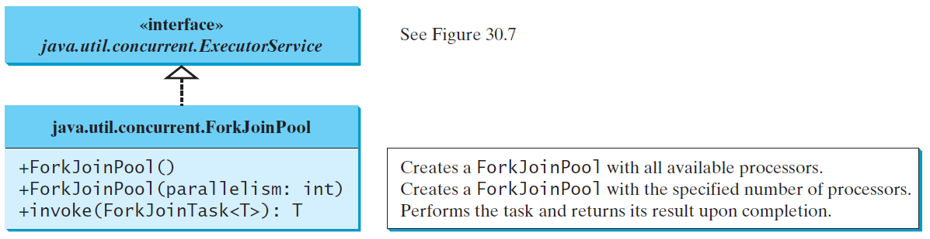
ForkJoinTask and ForkJoinPool
The framework defines a task using the ForkJoinTask class, and executes a task in an instance of ForkJoinPool.

Slide 108
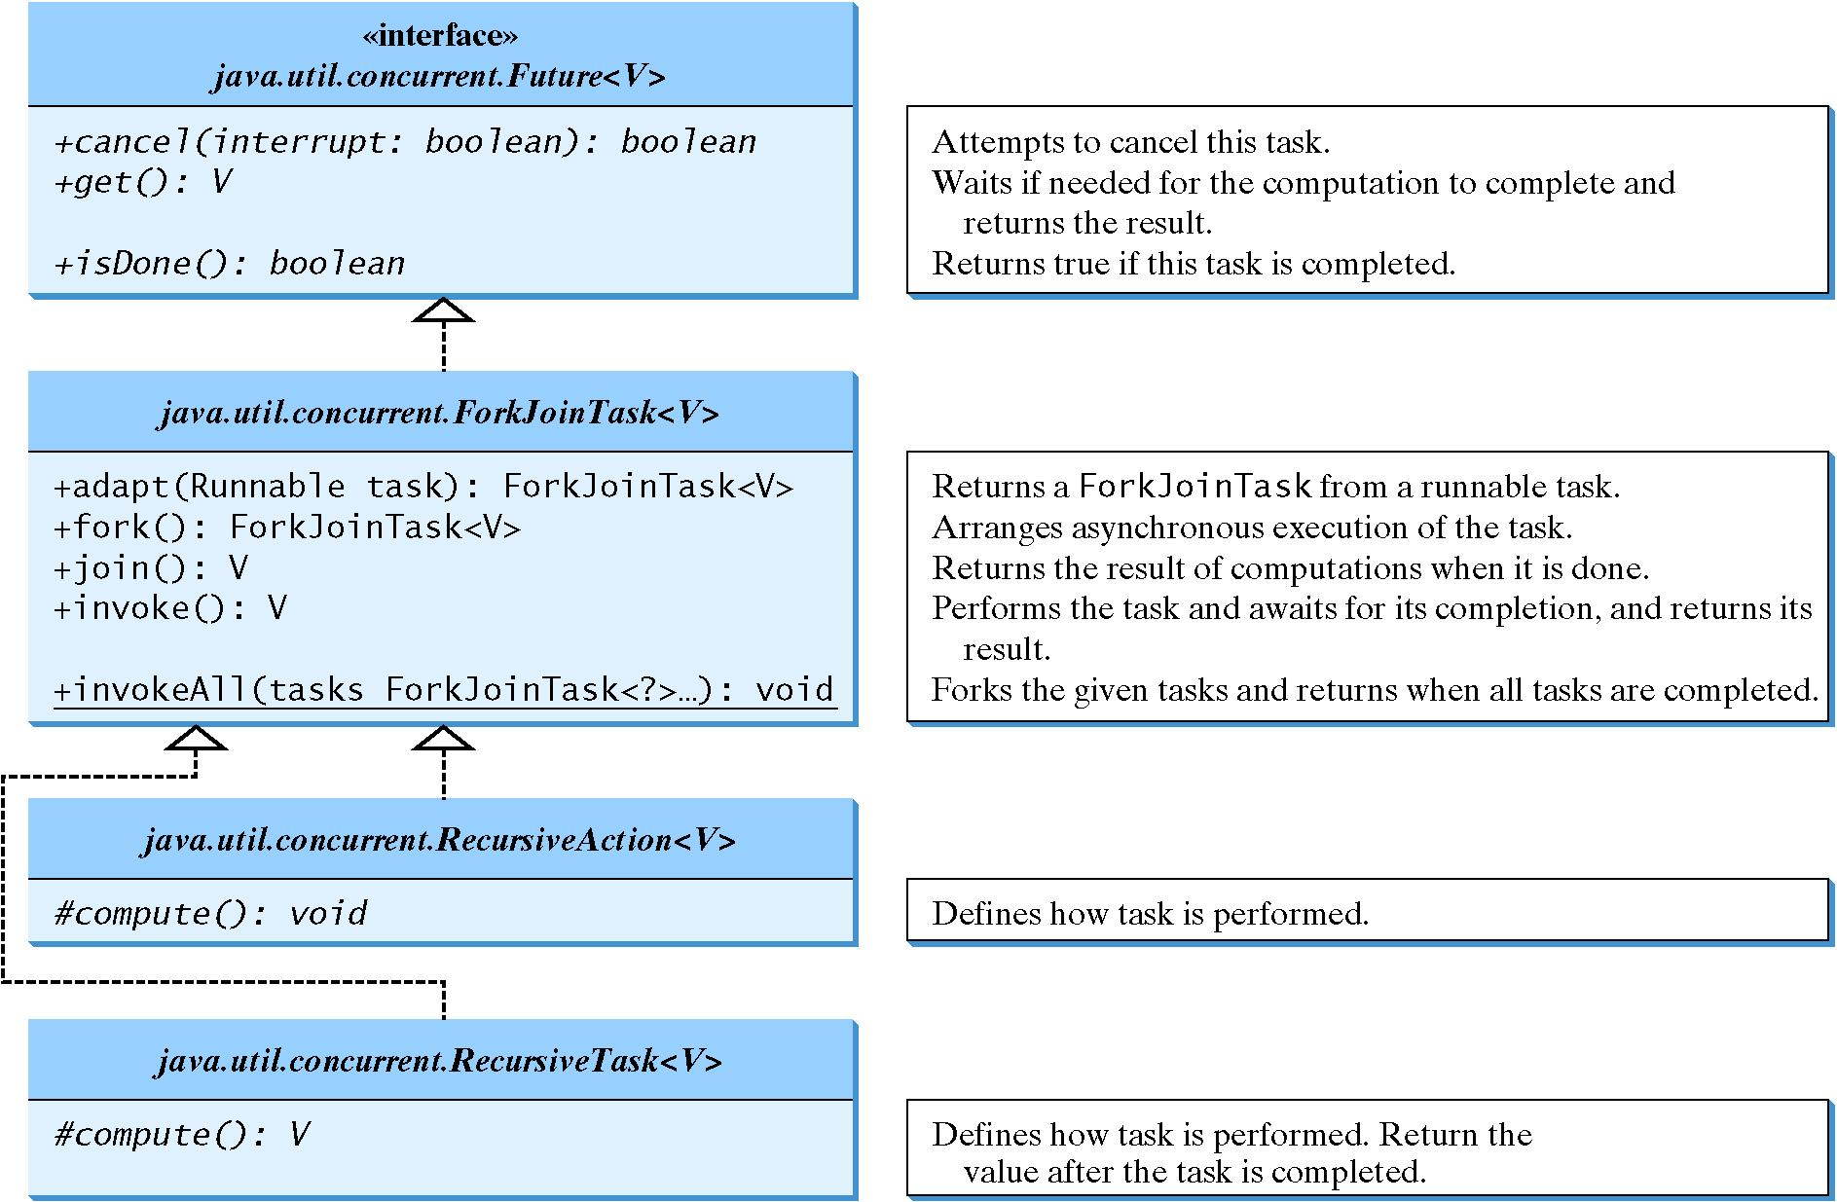
ForkJoinTask

Slide 109
Examples
ParallelMergeSort.java
  Calls both parallel and sequential version and times each
  If list is small enough (less than threshold), sorts sequentially
ParallelMergeSort
Run

Slide 110
ParallelMergeSort, divide and conquer
if (problem is small){
  solve sequentially
}
else {
  break problem into subproblems
  solve the subproblems
  combine the results to solve the problem
}

Slide 111
Examples
ParallelMax.java
  If list is small, find max sequentially
  Otherwise, break list into halves and find max from each half
  Then take the max of the max from each half
ParallelMax
Run

Slide 112
Vector, Stack, and Hashtable
Companion Website
Invoking synchronizedCollection(Collection c) returns a new Collection object, in which all the methods that access and update the original collection c are synchronized. These methods are implemented using the synchronized keyword. For example, the add method is implemented like this:
  public boolean add(E o) {
  synchronized (this) { return c.add(o); }
  }
The synchronized collections can be safely accessed and modified by multiple threads concurrently.
The methods in java.util.Vector, java.util.Stack, and Hashtable are already synchronized. These are old classes introduced in JDK 1.0. In JDK 1.5, you should use java.util.ArrayList to replace Vector, java.util.LinkedList to replace Stack, and java.util.Map to replace Hashtable. If synchronization is needed, use a synchronization wrapper.

Slide 113
Fail-Fast
Companion Website
The synchronization wrapper classes are thread-safe, but the iterator is fail-fast. This means that if you are using an iterator to traverse a collection while the underlying collection is being modified by another thread, then the iterator will immediately fail by throwing java.util.ConcurrentModificationException, which is a subclass of RuntimeException. To avoid this error, you need to create a synchronized collection object and acquire a lock on the object when traversing it. For example, suppose you want to traverse a set, you have to write the code like this:
  Set hashSet = Collections.synchronizedSet(new HashSet());
  synchronized (hashSet) { // Must synchronize it
  Iterator iterator = hashSet.iterator();
  while (iterator.hasNext()) {
  System.out.println(iterator.next());
  }
  }
Failure to do so may result in nondeterministic behavior, such as ConcurrentModificationException.

